Slide 1
BAKERY WEBSITE
A website to buy bakery products online
Made by:
Anshika
2111981045

Slide 2
Features of the website
User Friendly
You can see the products that are available in the Bakery
Responsive
Made with react

Slide 3
To be Added
Cart
Payment Gateway
Animations

Slide 4
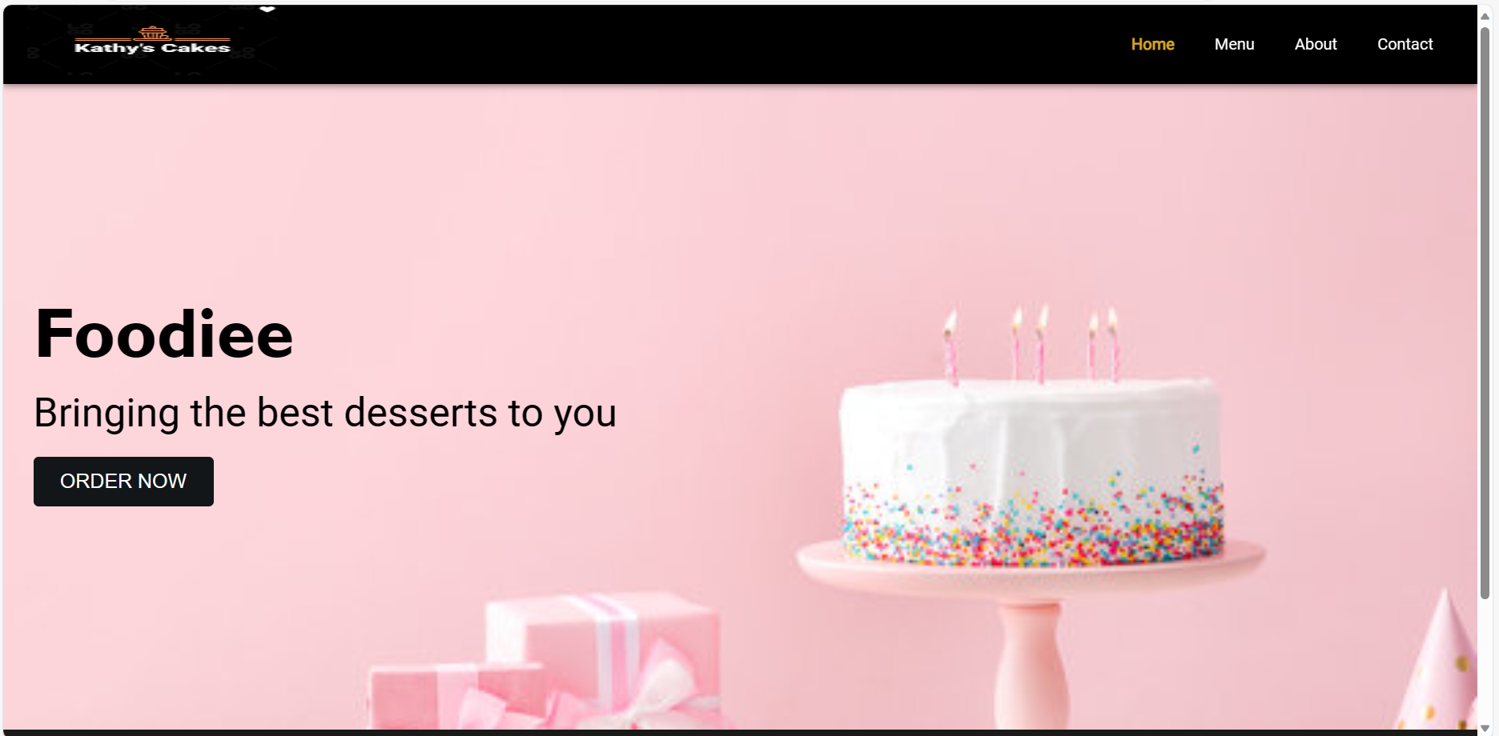
How does the website look?

Slide 5
THANK YOU!!

